Slide 1
Assignment 2
Judy O’Brien
Student No. 15725165

Slide 2
User Feature List
. . . . . List of user features . . . .
List of Searchable Cages (Alphabeth or Price)
Leave a comment on a Post
Add a Post
List of Cages with link to sub page
Add a Cage/ Update a Cage/ Delete a Cage
Gallery of Cages with links to Sub page
Follow link to social media sites
Developed a web API for assignment 1.
Technologies Used: Node, Express, MongoDB, Mongoose.
Integrated the API with your React client app. (Assignment 1)

Slide 3
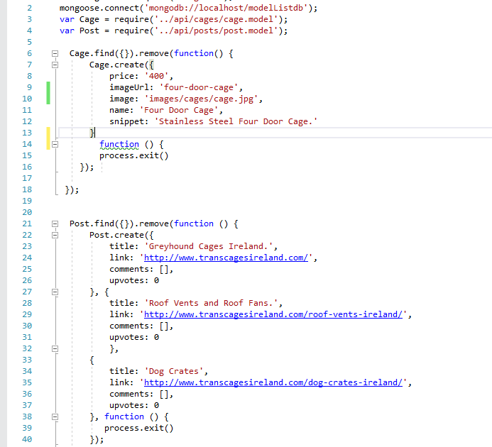
Data Model

Slide 4
API Endpoint List
Get /api/cages/
Delete /api/cages/_id
Post /api/cages/
Put /api/cages/_id
Get /api/posts/
Get /api/posts/title
Post /api/posts/
Post /api/post/:id
Put /api/posts/:id/upvotes
Post /api/post/post_id/
Put /api/post/post_id/commets/:comment_id/upvotes

Slide 5
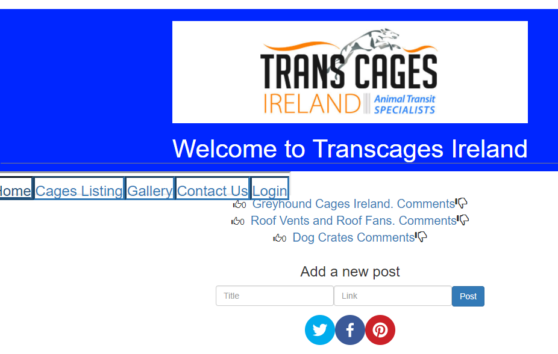

Slide 6
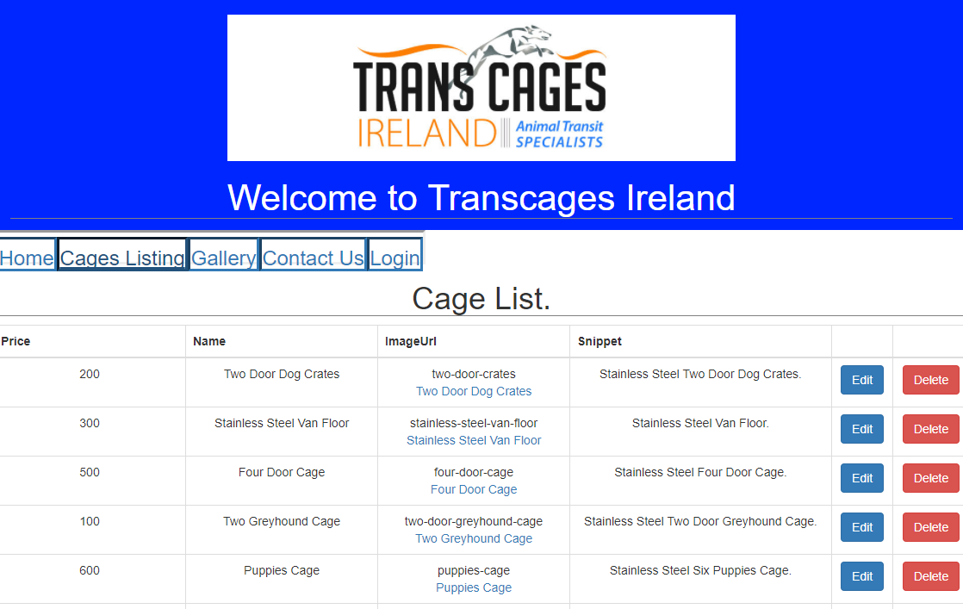

Slide 7
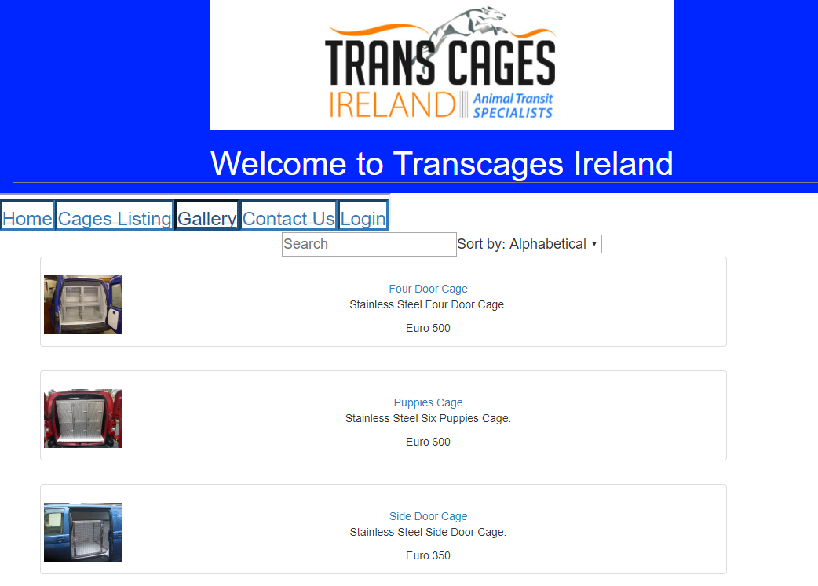

Slide 8
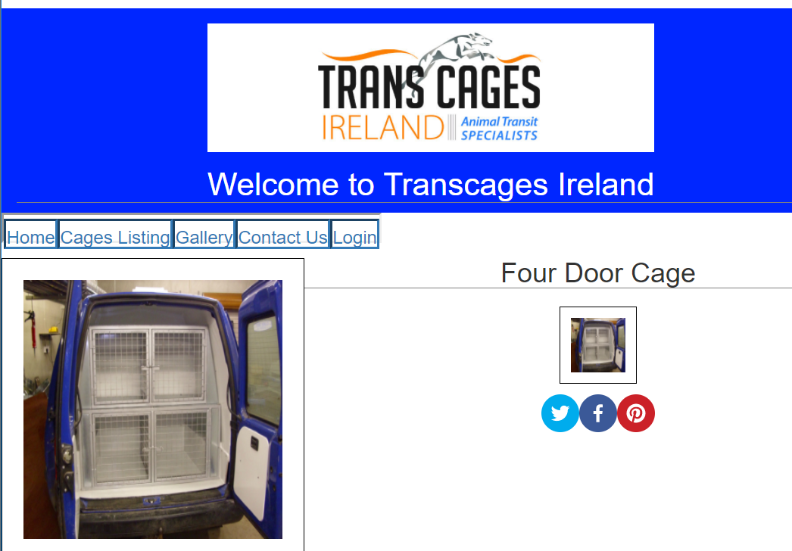

Slide 9
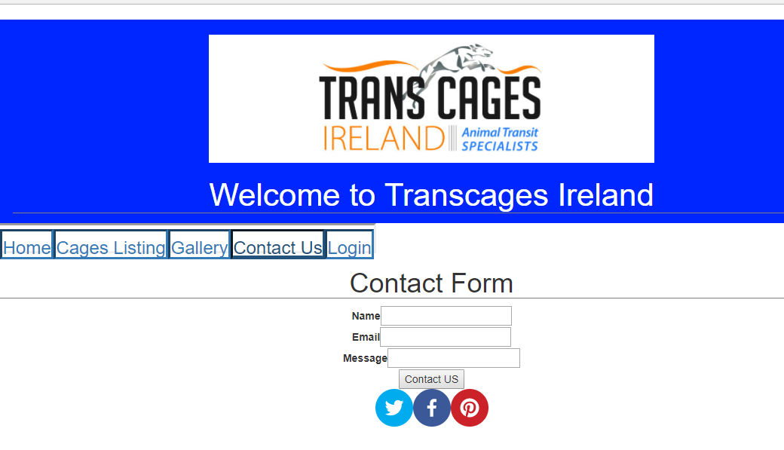

Slide 10
